Slide 1

Website Development: Lesson 3
Facilitated by: Titus Kariuki
Notes:
Web development kahoot

Slide 2
Getting ready for class
A laptop
Log into Codepen.io
Log into W3Schools
Attention!!!
Have the following: 👉🏽

Slide 3

Ice Breaker!
How was your Valentines?

Slide 4
Agenda
1. Ice breaker
2. Recap
3. Intro to CSS
4. How to Code CSS
5. Intro to CSS - Colors
6. Lesson 2 Challenge 1: Colorful Creature

Slide 5

Recap
What tag is used for creating lists?
What is the difference between opening tags and closing tags?
What tag is first used for inserting an image?

Slide 6
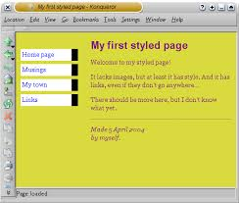
Intro to CSS - Cascading Style Sheet
What is CSS?
CSS = Cascading Style Sheet
CSS designs the website.
Colors
Fonts
Layouts
You can use CSS with anything.

Slide 7


Intro to CSS - Cascading Style Sheet
Difference between HTML and CSS:
HTML creates the web pages, CSS designs them.
CSS
HTML

Slide 8
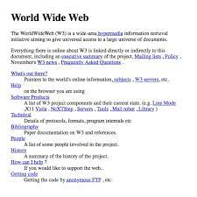
Intro to CSS - Cascading Style Sheet
Why do we need CSS?
You can play around with the design and layout of a web page.
You can change it for different devices; phone, laptop, and tablet.
Can make websites more accessible and cool.

Slide 9

Intro to CSS - Cascading Style Sheet

Slide 10
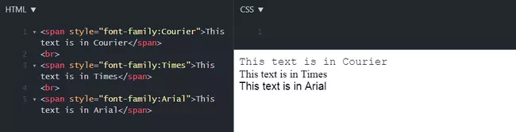
How to Code CSS
CSS can change the font, text color, and background colors in a code.

Slide 11

But wait…a quick break
Back to W3Schools

Slide 12
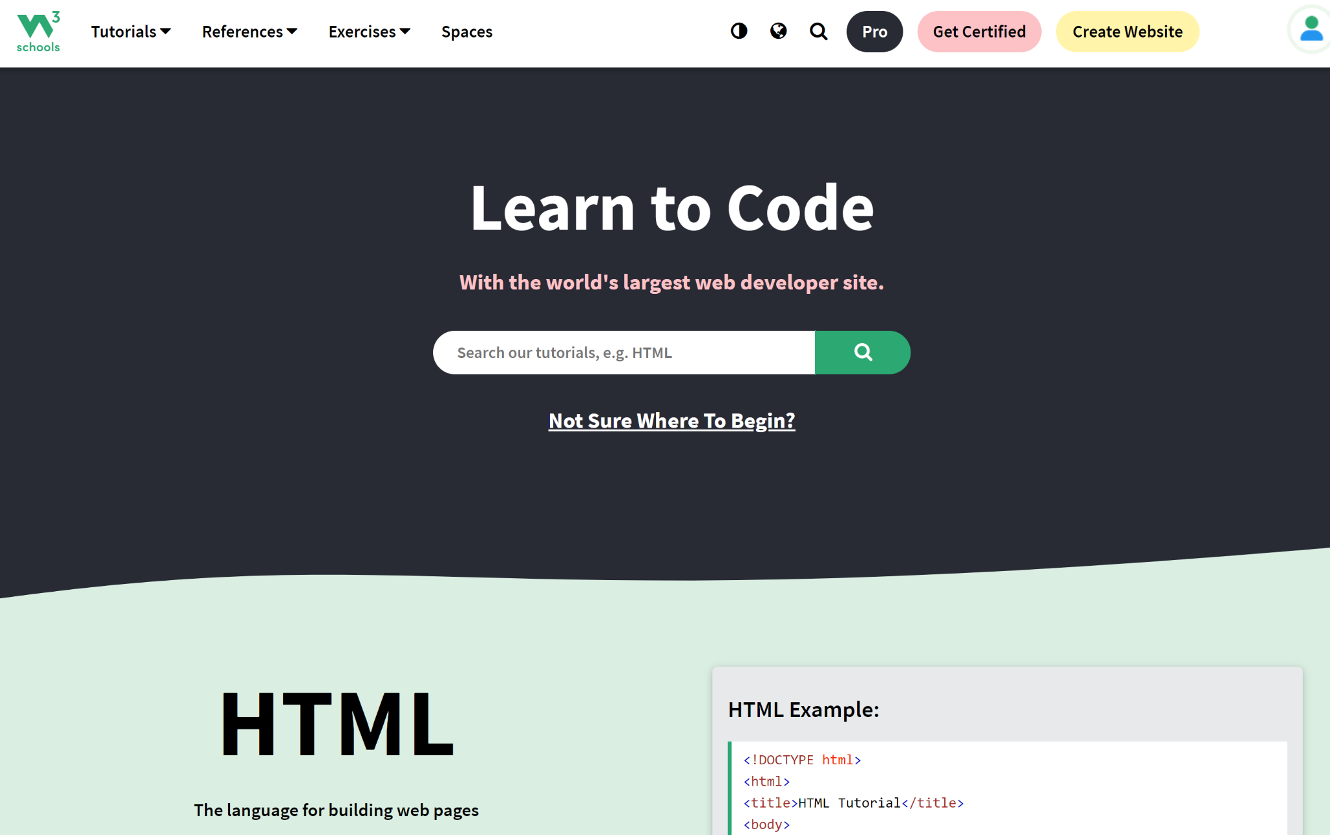
W3Schools
Do you remember W3Schools from last week?
If not:
Create an account on W3Schools.com
Use your personal email address
Choose “HTML” and “CSS”
Learn all you can.

Slide 13
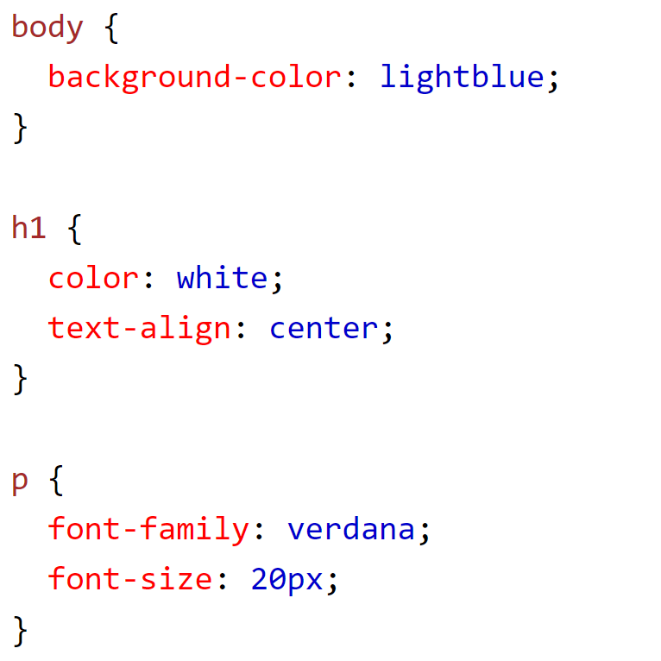
How to Code CSS
To code:
Find where you want to apply CSS
Write the CSS in open/close brackets

Slide 14
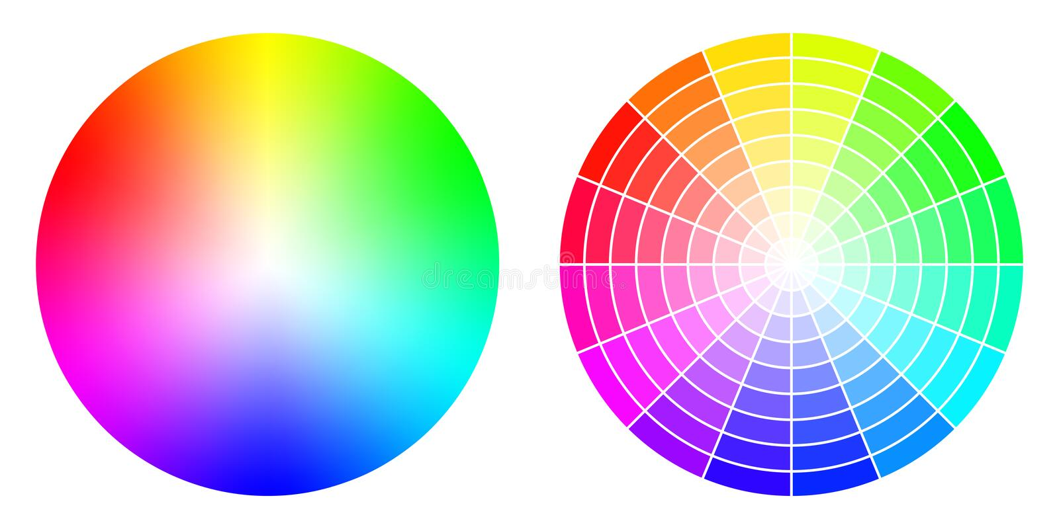
Intro to CSS - Colors
Computers do not recognize the English words for colors
Must talk to the computers in a language they understand
Specify colors in CSS using hex numbers or RGB values

Slide 15
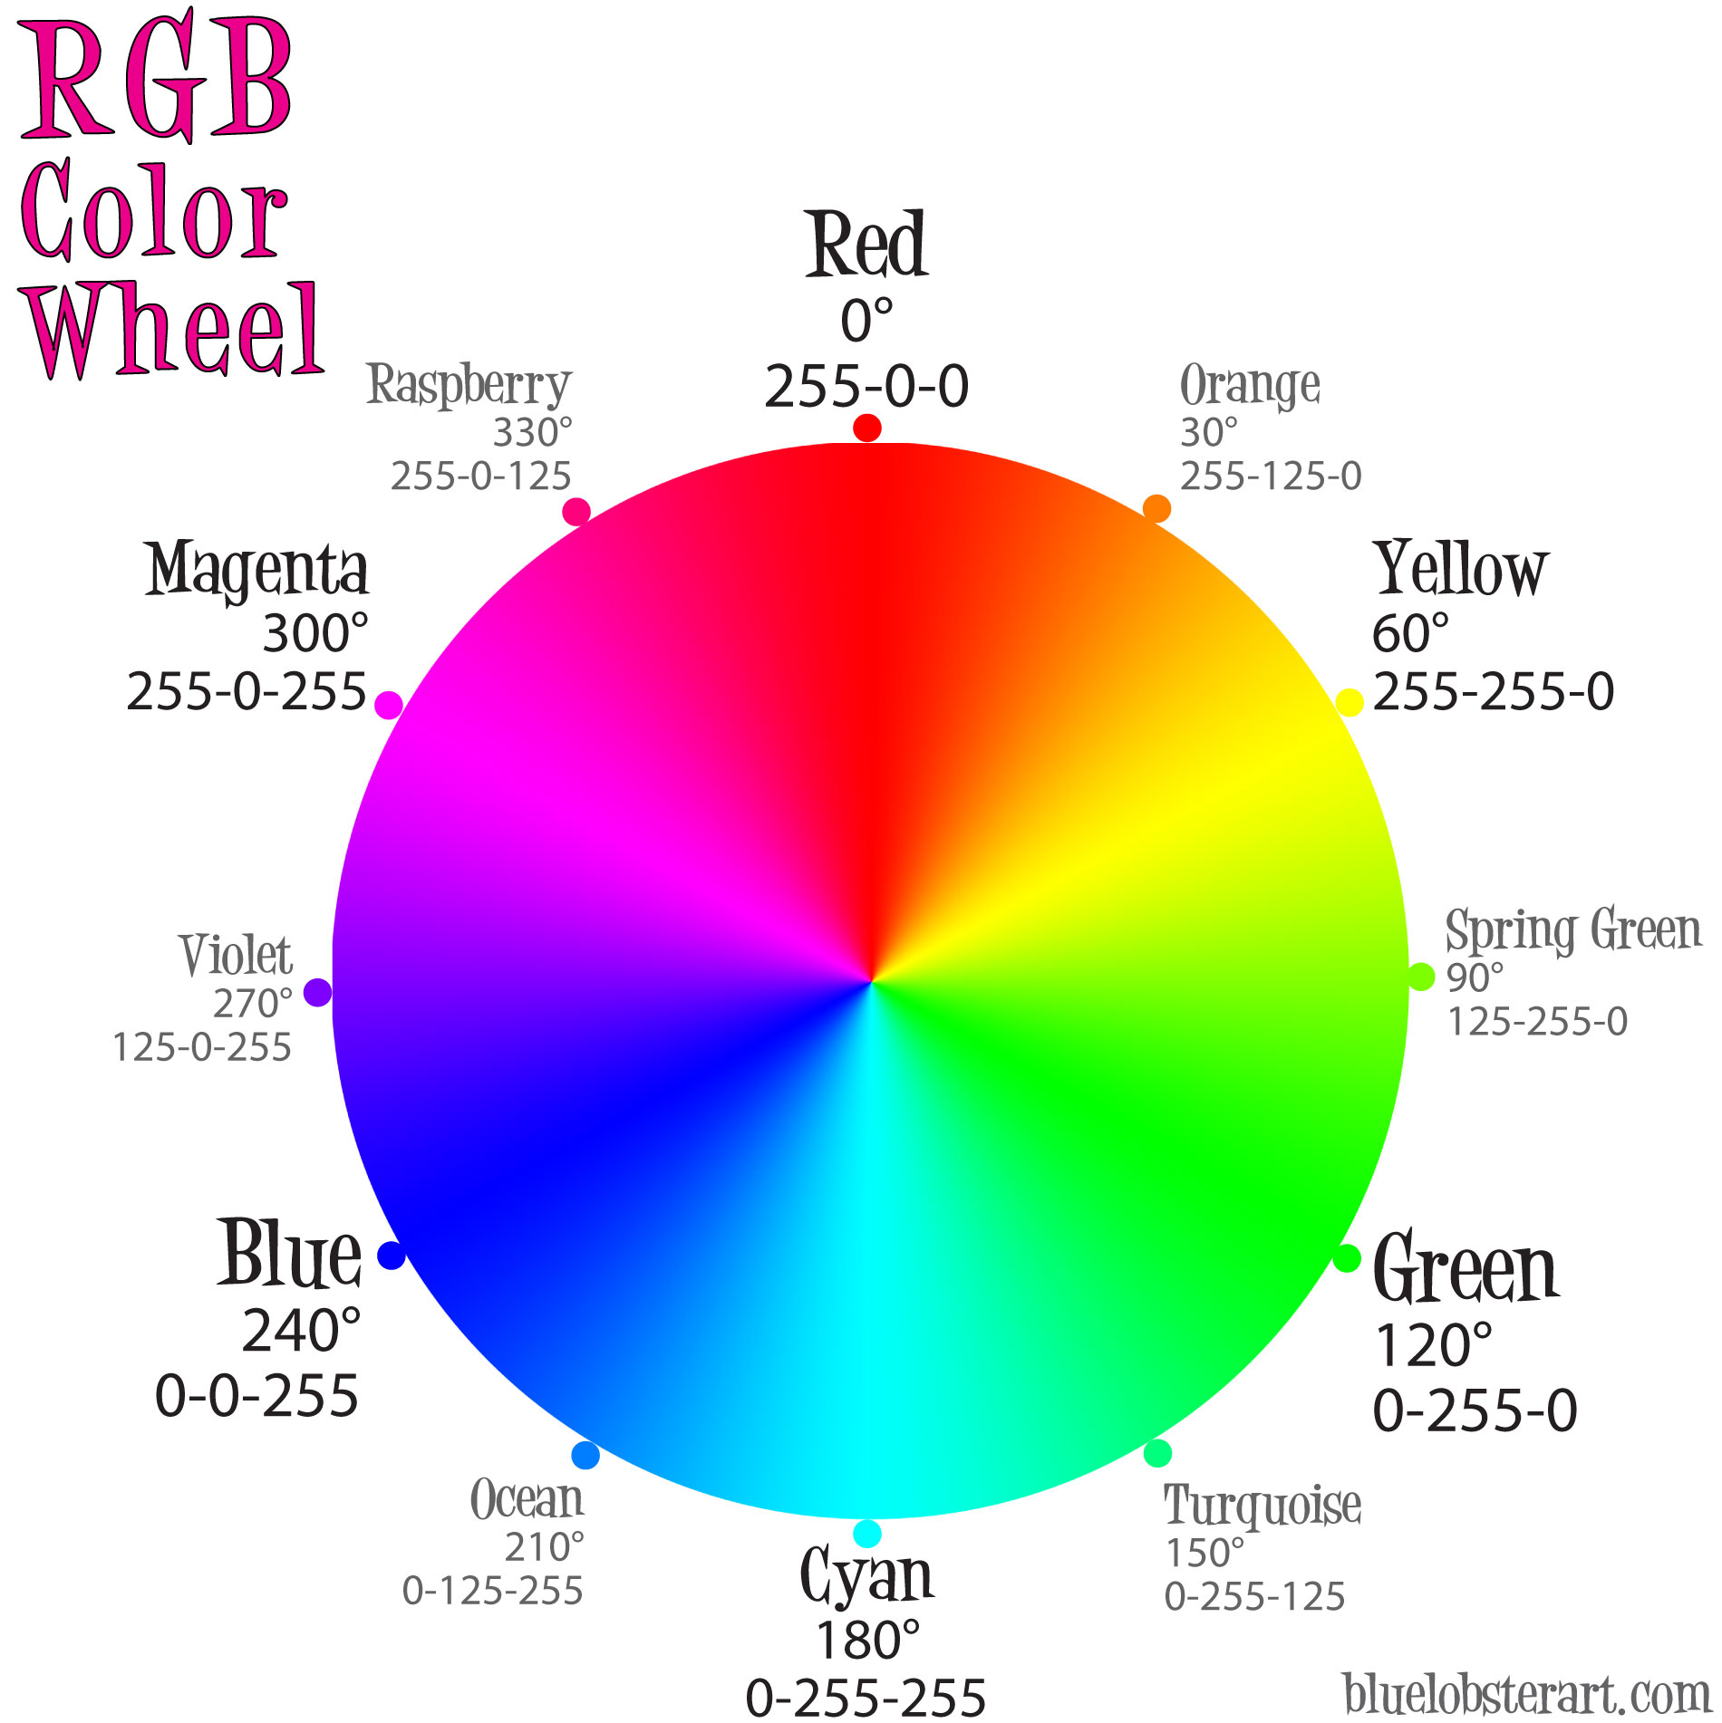
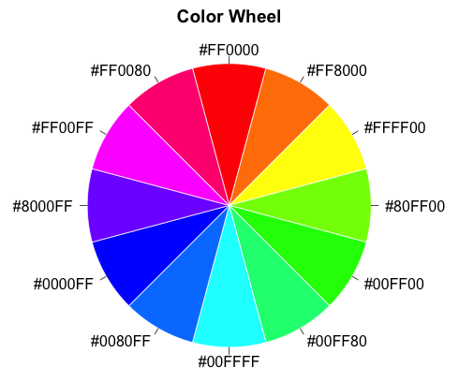
Intro to CSS - Colors
Hex Vs. RGB
Tells the computer how much red, green, and blue to display
Starts from (255,255,255) white to (0,0,0) black
More of shade ranges
Each color has a very unique number code
Starts with # followed by 6 values that can either be numbers or letters. Starts from #000000 (white) to #ffffff(black)

Slide 16
Intro to CSS - Colors
Open a new tab
Search HEX Color Picker
Choose the W3Schools HTML HEX Color Picker
Play around with it.
Repeat the same for RGB Color Picker

Slide 17
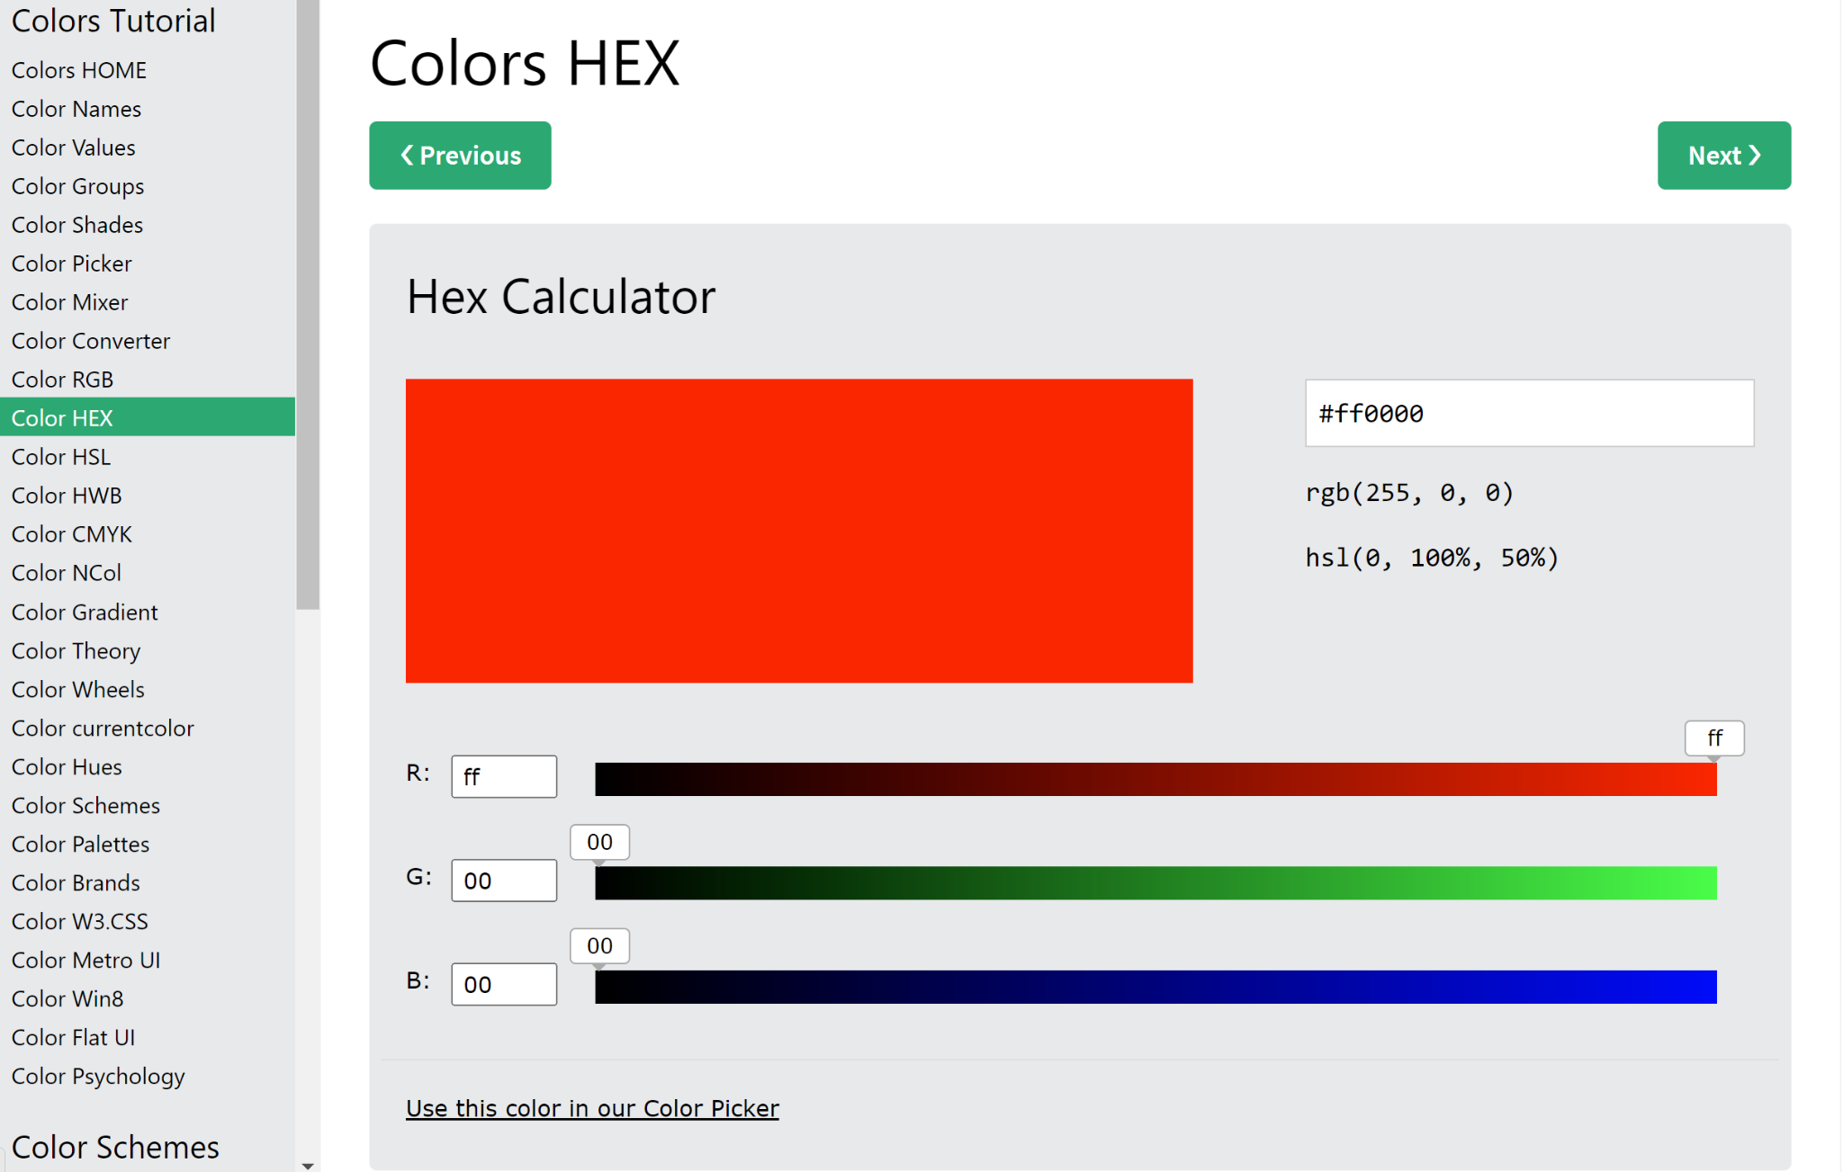
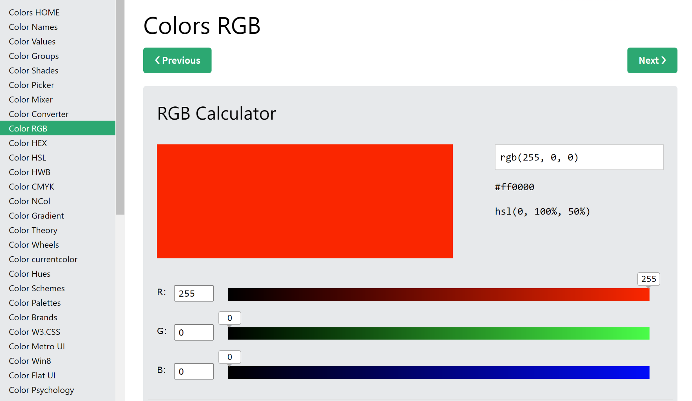
Intro to CSS - Colors
You should be at a page that looks like this:

Slide 18
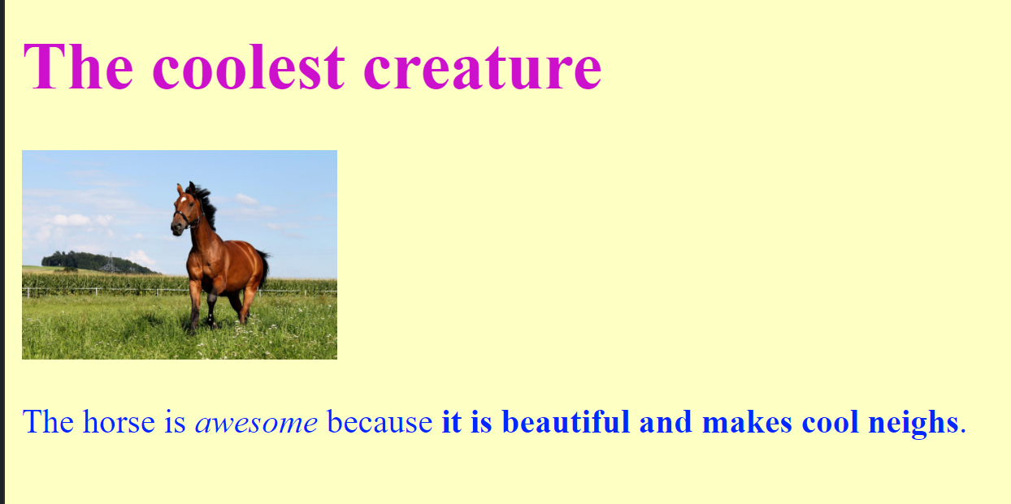
Lesson 2 Challenge 1: Colorful Creature
Use CSS to describe your favorite animal!!
Things you will need:
Declare your webpage using html tags
Title
Background
Background color (CSS)
Heading
Font and color (CSS)
Body paragraph describing your chosen animal
Font and color (CSS)
Picture of your animal

Slide 19
Lesson 2 Challenge 1: Colorful Creature
Hints for when you get stuck!
-anything opened must be closed
Ex: <p>...</p>
must declare your webpage as an html document type
CSS uses the RGB color scale
-(red, green, blue)
-ex: Color pink written as (255, 192, 203)

Slide 20

Questions?

Slide 21

Closing Survey
Fill out this survey to help me teach you better. It’s secret:
https://tinyurl.com/32ay68rt

